Slide 1
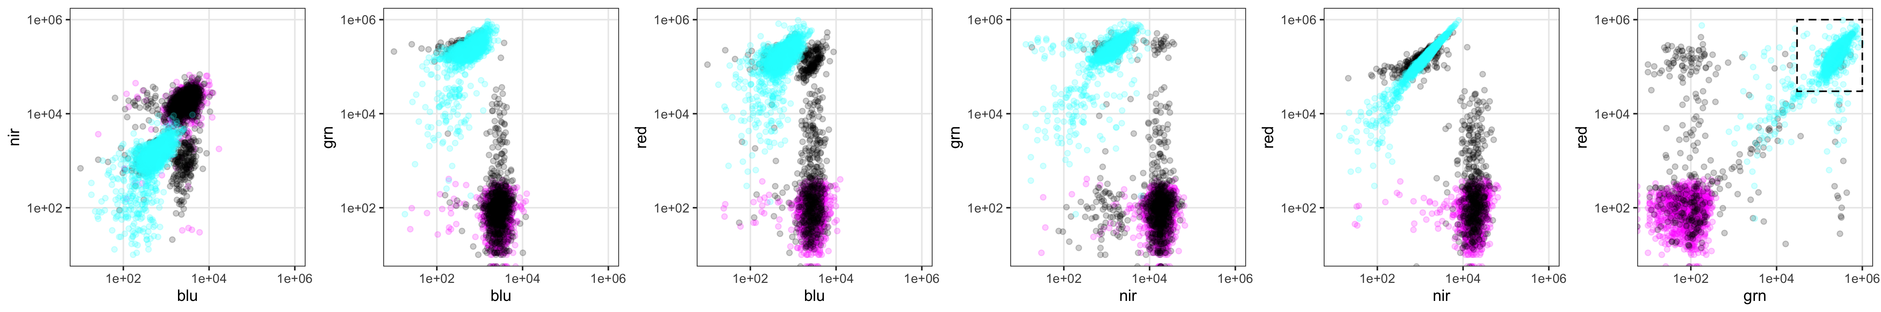
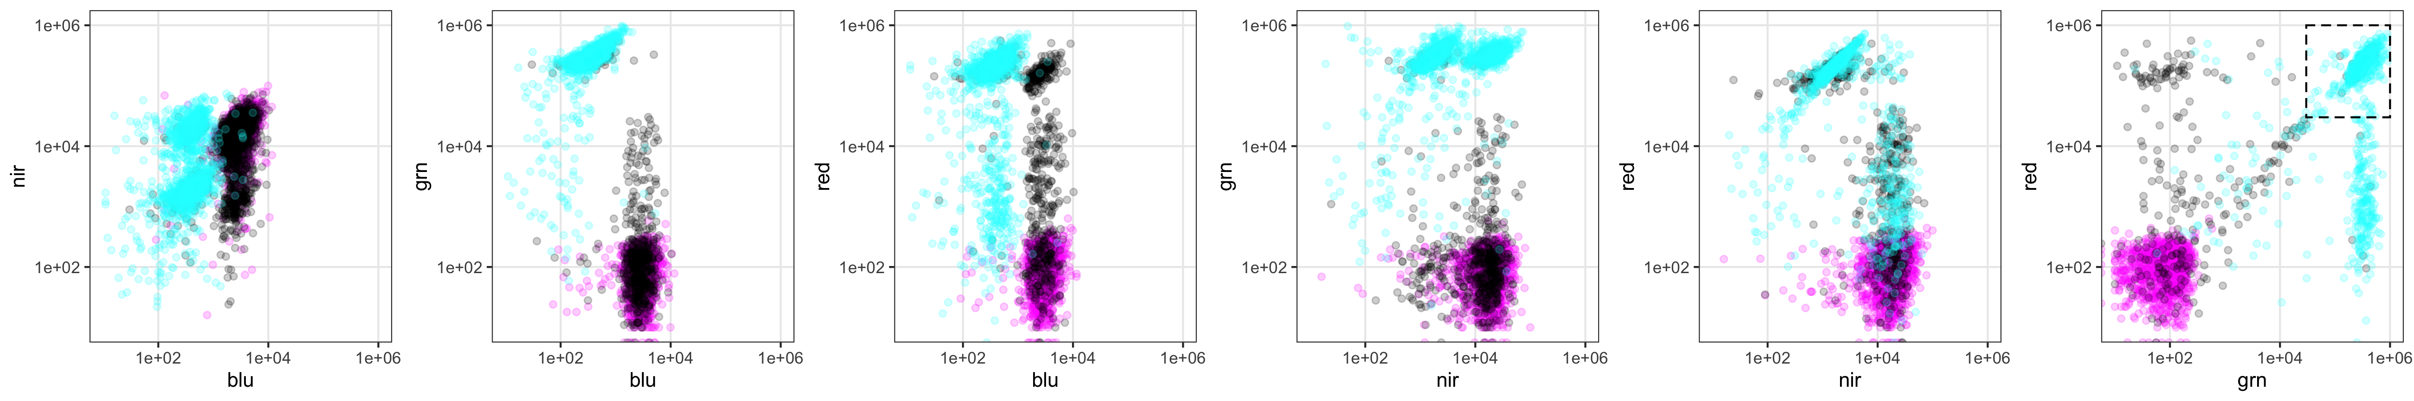
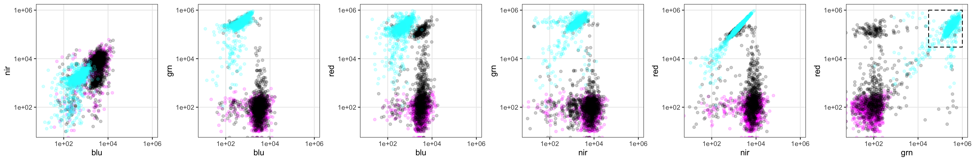
None
Recombined
Selected
201002 data
Clone2
Clone6
Clone11

Slide 2
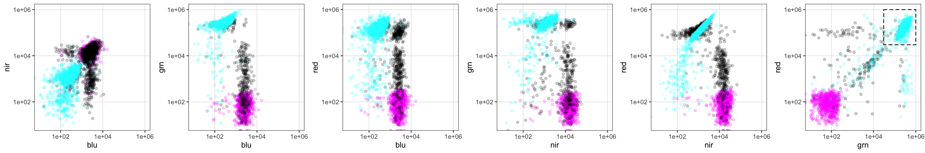
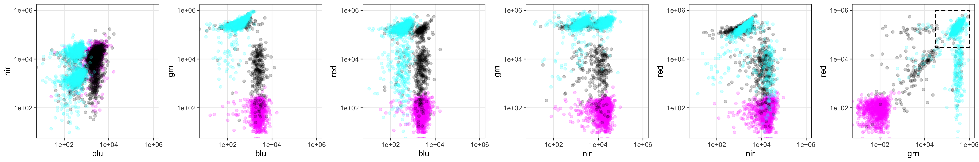
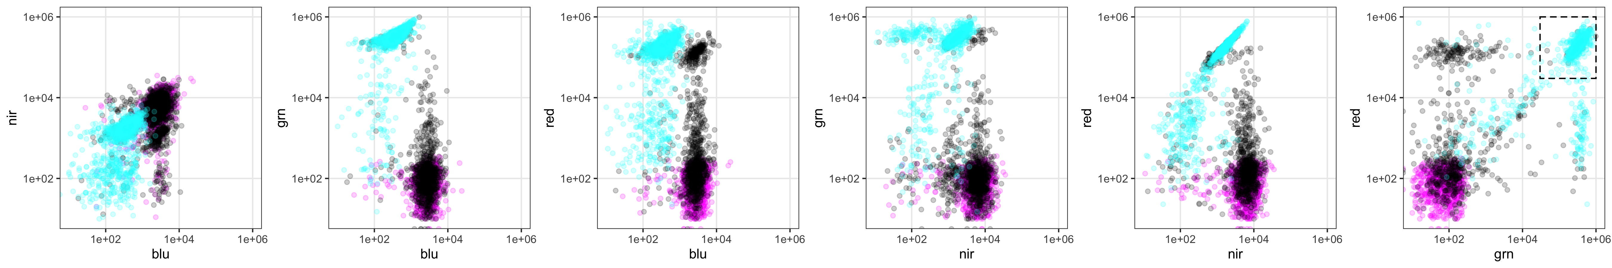
None
Recombined
Selected
201016 data
Clone2
Clone6
Clone11

Slide 3
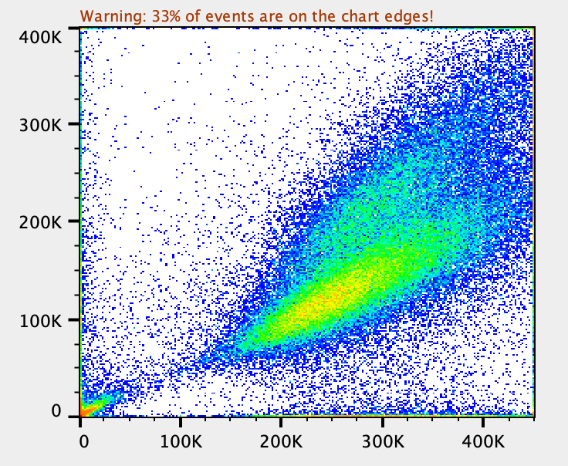
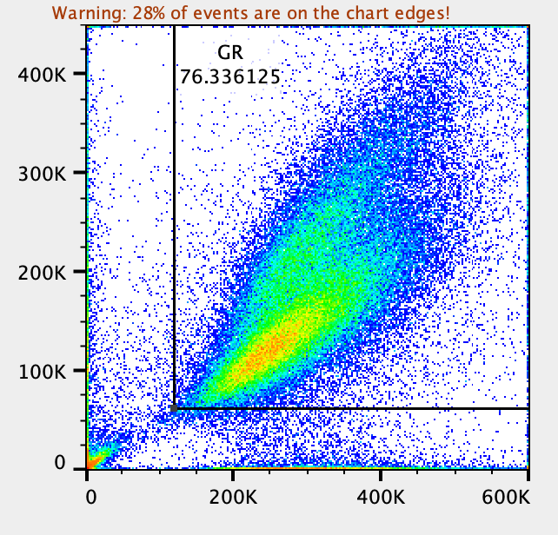
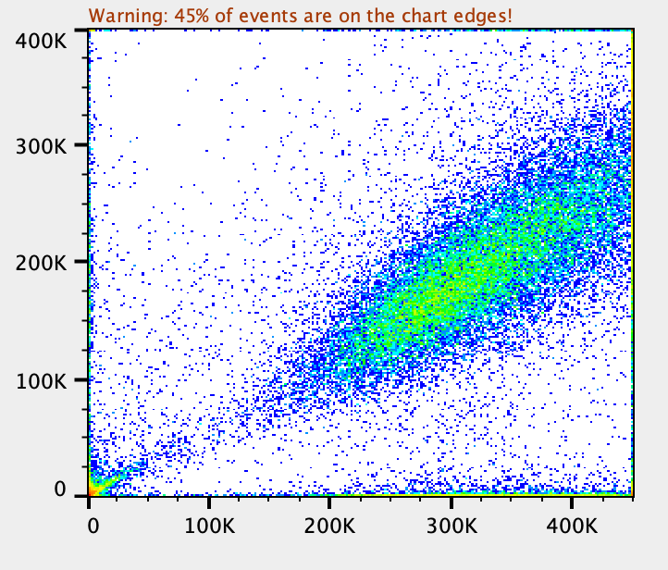
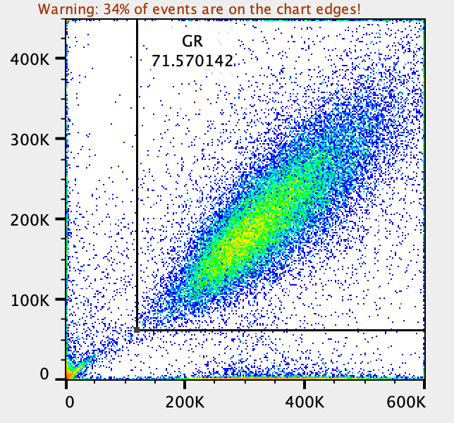
Some initial thoughts:
Its weird that AP1903 selection of Clone 6 doesn’t result in 100% B-N- cells. Instead, 50% of the cells are B-N+. Weird!
Also it’s weird that AP1903 selection of Clone 6 doesn’t result in 100% G+N- cells. Instead, 50% of cells are G+N+. Something is up, where half of the N+ cells don’t die with AP903 selection. That is bad. I am hereby ruling out Clone 6!
OK, so Clone 2 and Clone 11 are still in the running.
Clone 2 has a weird doublet when looking at G+Y+ cells. This happened in both replicates. I dunno what this is, but it’s a red flag in my book.
Clone 11 is kind of dim in the nir channel, but that’s the least of all of the problems identified. Thus, I think we should go with Clone 11.
OK, my conclusion is that we should go with Clone 11!
Rep1
Rep2
c2
c6

